Slide 1

LUIS
Machine Learning Conference
Rainer Stropek
software architects gmbh
Web
Mail
Twitter
http://www.timecockpit.com
rainer@timecockpit.com
@rstropek
Language Understanding

Slide 2
Agenda
Conversational UIs is an important concept for future apps. Yet, adding support for natural language understanding is hard. Microsoft offers the Language Understanding Intelligent Service (LUIS) that should make natural language support feasible for enterprise apps. The Machine Learning-based service offers a cross-platform Web API so that it can be used from any platform and technology. In this session, long-term Microsoft MVP and Regional Director Rainer Stropek starts by introducing the fundamental concepts of LUIS. Based on this, he shows live-coding demos where LUIS is used to build Bots.

Slide 3
Background

Slide 4

Image by Nick Youngson CC BY-SA 3.0 Alpha Stock Images

Slide 5
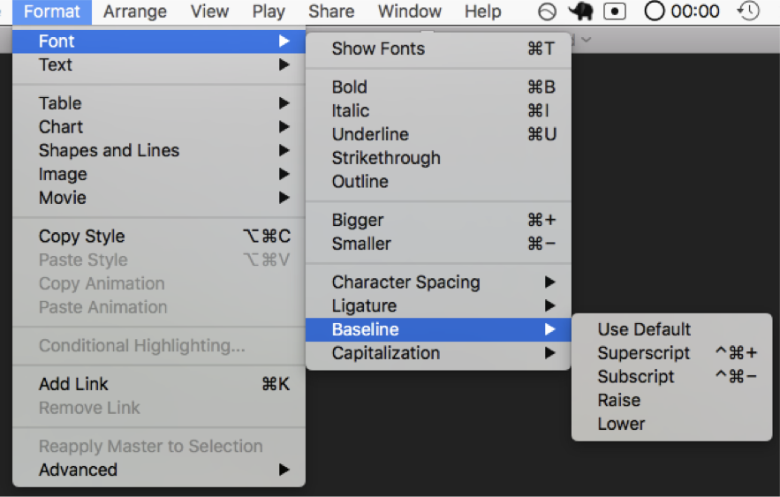

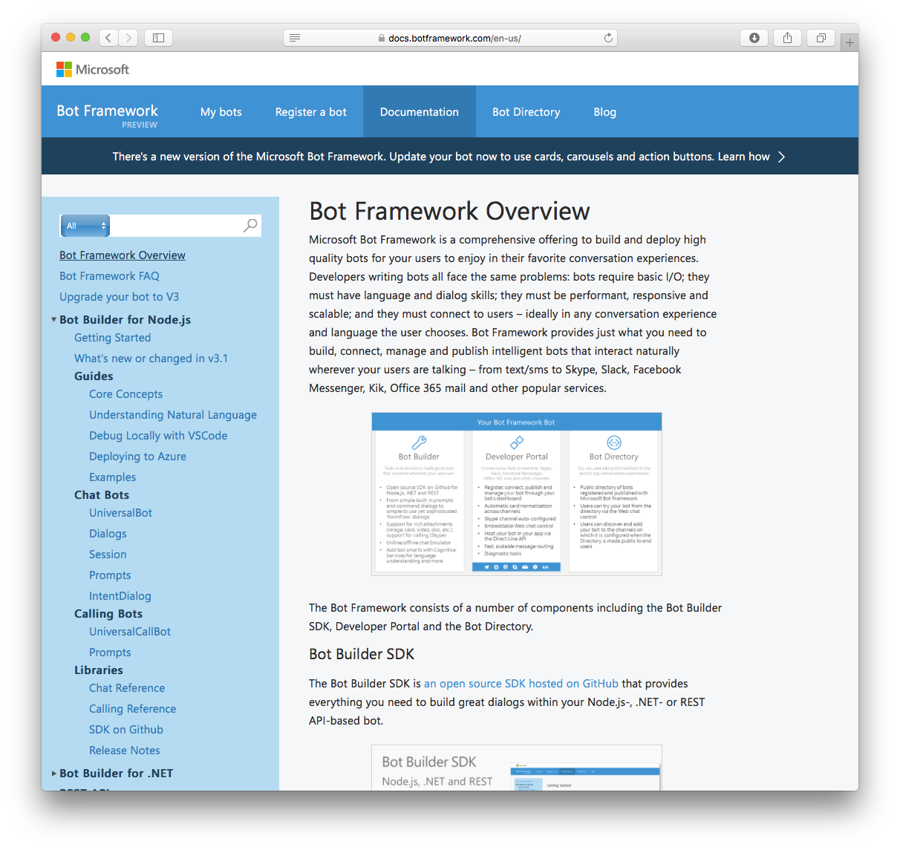

Slide 6
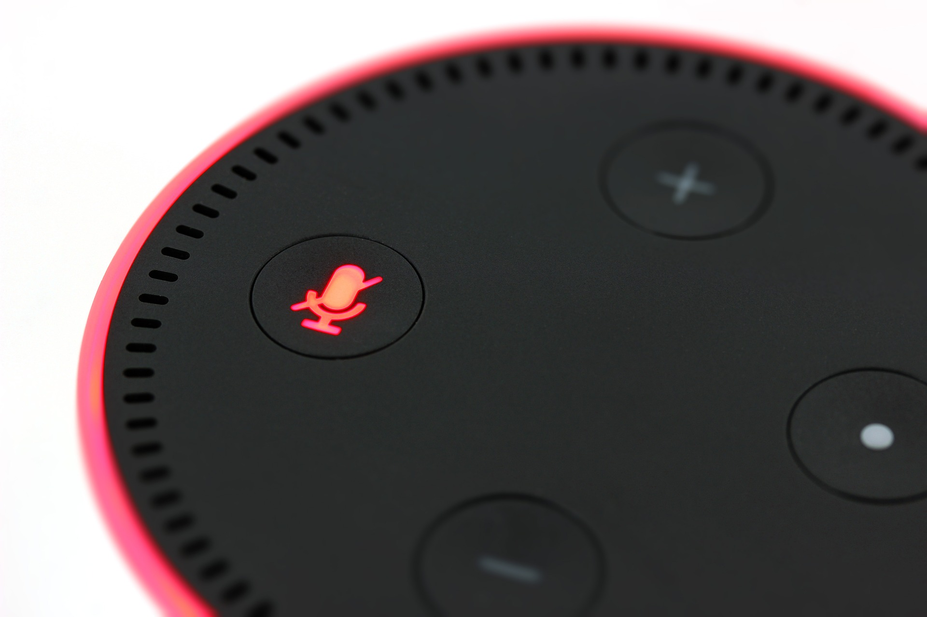
New User Interfaces

Slide 7
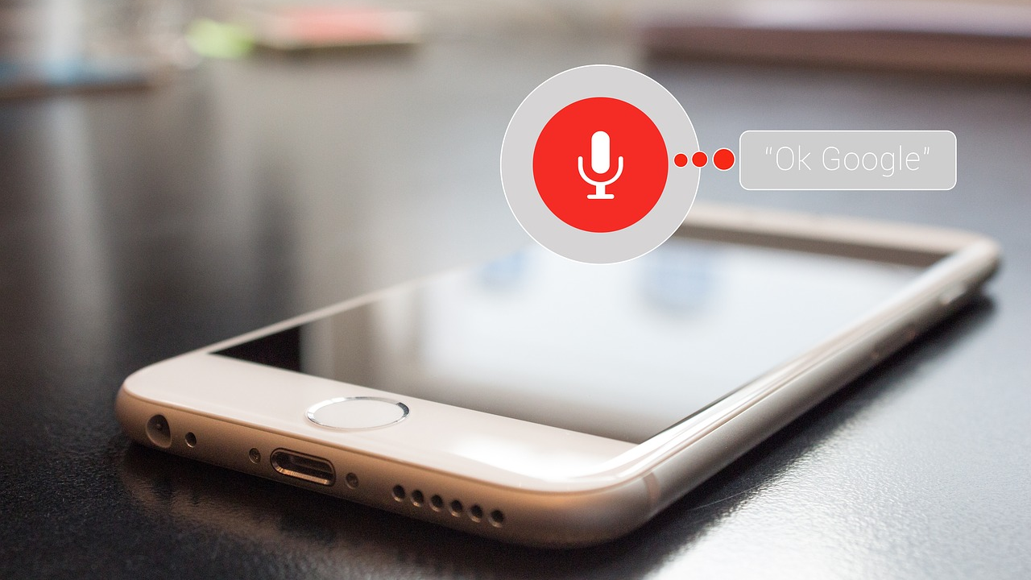
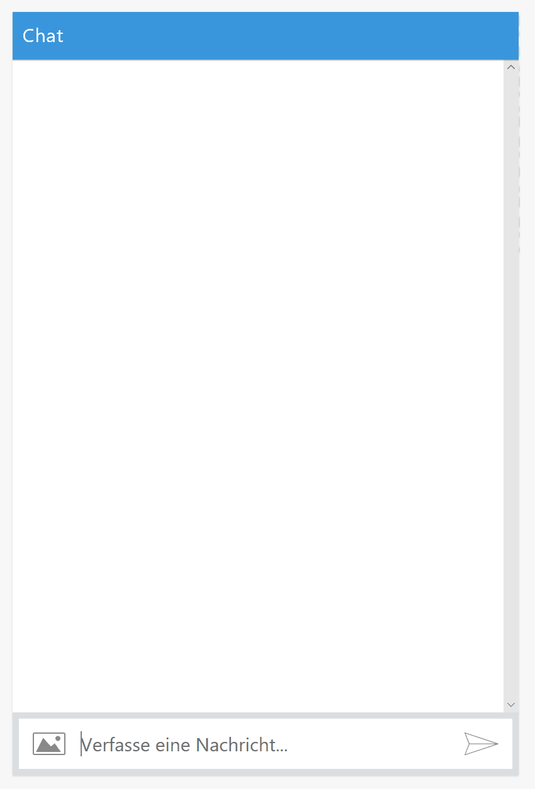
New User Interfaces

Slide 8
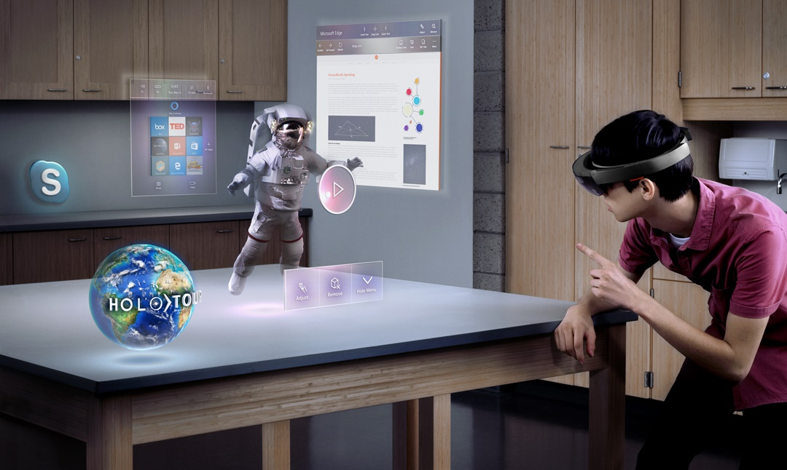
New User Interfaces

Slide 9
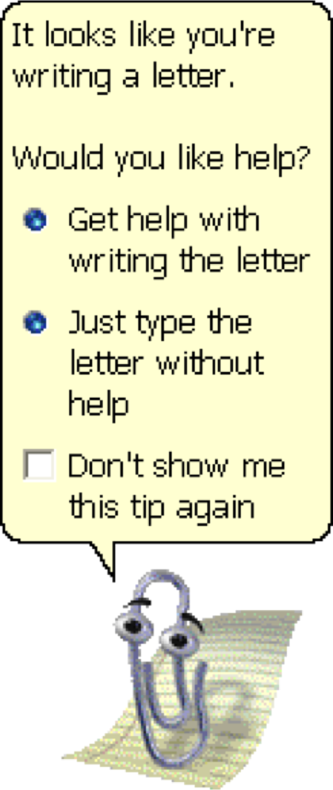
New User Interfaces

Slide 10
What‘s LUIS?
LUIS as part of Microsoft‘s Cognitive Services

Slide 11
Cognitive Services
Versatility, Control
Deep Learning Toolkits (e.g. CNTK, TensorFlow, etc.)
Commodity services
Solve common ML problems
Configurable
Build custom models
Train with custom data
Affordable
Rich out-of-the-box functionality
Easy-to-use API (HTTP, language-specific)
Pricing models
Enterprise-ready
SLAs
Global availability (e.g. GDPR)
High-Level APIs (e.g. Keras, etc.)
Cognitive Services
Development Effort

Slide 12



Microsoft Cognitive Services
Make ML available to developers without deep ML skills
Vision
From faces to feelings, allow your apps to understand images and video
Speech
Hear and speak to your users by filtering noise, identifying speakers, and understanding intent
Language
Process text and learn how to recognize what users want
Knowledge
Tap into rich knowledge amassed from the web, academia, or your own data
Search
Access billions of web pages, images, videos, and news with the power of Bing APIs
Labs
An early look at emerging Cognitive Services technologies: discover, try & give feedback on new technologies before general availability

Slide 13
Bots and Language Understanding
Don‘t want to solve the Turing Test
Simple task automation utility
Apps with a new UI
Intention recognition
Understand the users intent from a given message
Source: Text or audio
Entity extraction
Extract parameters (=entities) from the message
E.g. keys (e.g. flight number), dates (e.g. „in two days“), entity types (e.g. email, appointment)
Sentiment, language
Drives the bot‘s conversation with the user

Slide 14




LUIS
Creating and maintaining the model
Portal (global, EU)
RESTful Web API
Acquire keys through Azure Portal
Active Learning
Identify unclear utterances
Label them
Iterate model quickly
Train by providing examples or importing pre-build elements
Create your own LU model
Deploy to an HTTP endpoint
Maintain model

Slide 15
Working with LUIS
It is demo time!

Slide 16
Building a Model
Intents
Creating intents
Adding utterances
Pre-built intents
Entities
Entity types
Pre-build entities
Phrases and Patterns
Model settings
Import and export
Testing
Exploratory vs. batch

Slide 17
Deployment
Training the model
Publish model
Get key through Azure Portal
Staging and production
Use model
REST queries

Slide 18
Development
Use RESTful Web API from Angular

Slide 19
Building Bots

Slide 20
Bot Framework
Service abstracting conversation channels
SMS, Slack, Mail, etc.
API simplifying building of bots
Based on ASP.NET (Core)
Bot Builder v4 (currently in preview; GitHub)
Special classes for LUIS integration
Read more in docs
See also https://blog.botframework.com/2018/05/07/build-a-microsoft-bot-framework-bot-with-the-bot-builder-sdk-v4/

Slide 21
An x-ray of a typical bot
Conversation Canvas/Channels
Your code goes here
Web Chat
Bot Connector Service
Email
Message input <> output
State Management
Facebook
GroupMe
Your bot code
Bot Builder SDK
Kik
Skype
Bot Builder SDK
API, SDK calls
Slack
+ Microsoft Cognitive Services
Telegram
Other services, APIs,
Databases, Azure Machine Learning, Azure Search, etc…
Natural Language
Translation
Vision/Face
Emotion
Twilio (SMS)
…
Direct Line…
Speech
Entity Extraction
Search
Knowledge API
…
…
…

Slide 22
Bot with LUIS

Slide 23
Summary

Slide 24
Summary
Simple, affordable language understanding
Make language queries and/or bots available for every app
No need for in-depth ML skills
Cross-platform
Integration with Bot Builder
Make common scenario (LU + bot) simple
Can be used outside of bots
Integration with other Cognitive Services
Speech services
Sentiment analysis

Slide 25
Q&A
LUIS – Language Understanding
Rainer Stropek
software architects gmbh
Mail Web Twitter
rainer@timecockpit.com http://www.timecockpit.com @rstropek
Thank your for coming!

